Slide 1
SQL II
R & G - Chapter 5

Slide 2
SQL DML 1: Basic Single-Table Queries
SELECT [DISTINCT] <column expression list> FROM <single table> [WHERE <predicate>] [GROUP BY <column list> [HAVING <predicate>] ] [ORDER BY <column list>] [LIMIT <integer>];

Slide 3
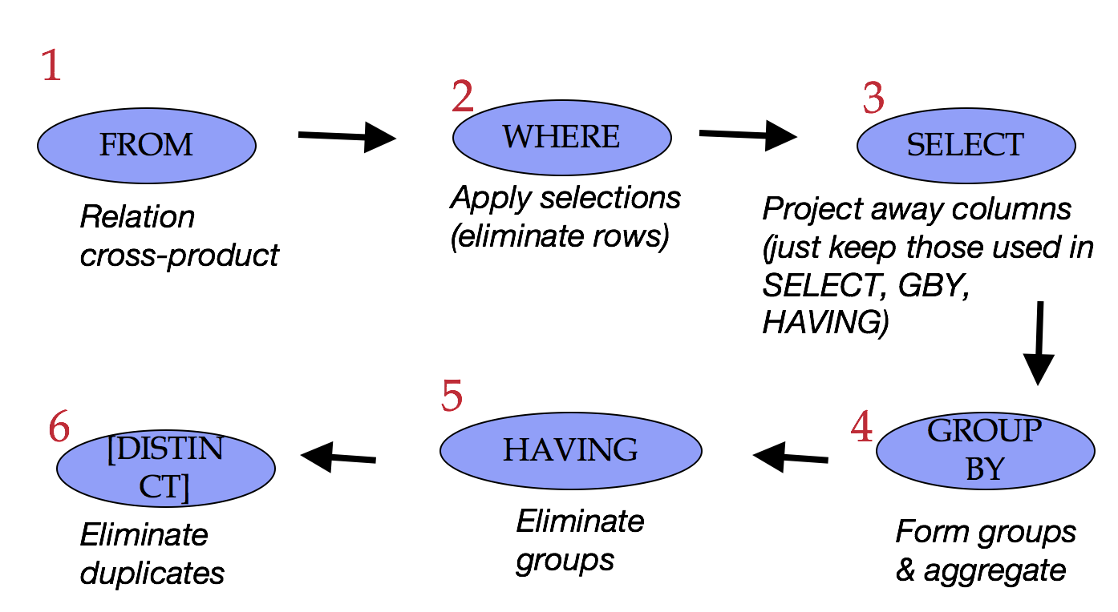



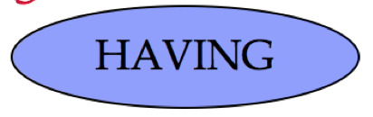
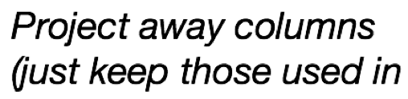
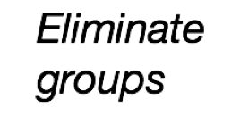

Conceptual SQL Evaluation
SELECT [DISTINCT] target-list
FROM relation-list
WHERE qualification
GROUP BY grouping-list
HAVING group-qualificati

Slide 4
Putting it all together
SELECT S.dept, AVG(S.gpa), COUNT(*) FROM Students S WHERE S.gender = 'F' GROUP BY S.dept HAVING COUNT(*) >= 2 ORDER BY S.dept;

Slide 5
Content Break

Slide 6
Join Queries
SELECT [DISTINCT] <column expression list> FROM <table1 [AS t1], ... , tableN [AS tn]> [WHERE <predicate>] [GROUP BY <column list>[HAVING <predicate>] ] [ORDER BY <column list>];

Slide 7
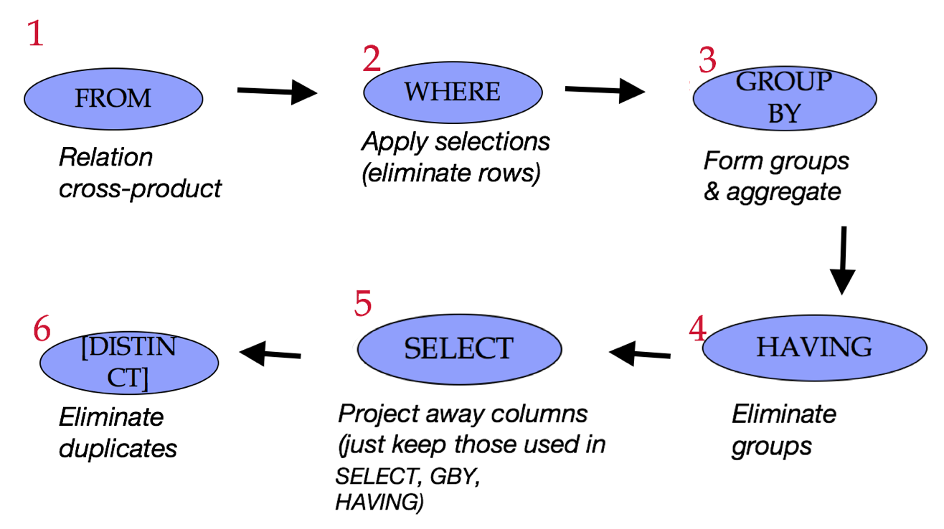
Conceptual SQL Evaluation, cont
SELECT [DISTINCT] target-list
FROM relation-list
WHERE qualification
GROUP BY grouping-list
HAVING group-qualificati

Slide 8
Cross (Cartesian) Product
All pairs of tuples, concatenated
Sailors
Reserves
sid | sname | rating | age
1 | Popeye | 10 | 22
2 | OliveOyl | 11 | 39
3 | Garfield | 1 | 27
4 | Bob | 5 | 19
sid | bid | day
1 | 102 | 9/12
2 | 102 | 9/13
1 | 101 | 10/01
sid | sname | rating | age | sid | bid | day
1 | Popeye | 10 | 22 | 1 | 102 | 9/12
1 | Popeye | 10 | 22 | 2 | 102 | 9/13
1 | Popeye | 10 | 22 | 1 | 101 | 10/01
2 | OliveOyl | 11 | 39 | 1 | 102 | 9/12
… | … | … | … | … | … | ...

Slide 9
Find sailors who’ve reserved a boat
SELECT S.sid
FROM Sailors AS S, Reserves AS R
WHERE S.sid=R.sid
sid | sname | rating | age
1 | Popeye | 10 | 22
2 | OliveOyl | 11 | 39
3 | Garfield | 1 | 27
4 | Bob | 5 | 19
sid | bid | day
1 | 102 | 9/12
2 | 102 | 9/13
1 | 101 | 10/01
sid | sname | rating | age | sid | bid | day
1 | Popeye | 10 | 22 | 1 | 102 | 9/12
1 | Popeye | 10 | 22 | 2 | 102 | 9/13
1 | Popeye | 10 | 22 | 1 | 101 | 10/01
2 | OliveOyl | 11 | 39 | 1 | 102 | 9/12
… | … | … | … | … | … | ...

Slide 10
Find sailors who’ve reserved a boat cont
SELECT S.sid
FROM Sailors AS S, Reserves AS R
WHERE S.sid=R.sid
sid | sname | rating | age
1 | Popeye | 10 | 22
2 | OliveOyl | 11 | 39
3 | Garfield | 1 | 27
4 | Bob | 5 | 19
sid | bid | day
1 | 102 | 9/12
2 | 102 | 9/13
1 | 101 | 10/01
sid | sname | bid
1 | Popeye | 102
1 | Popeye | 101
2 | OliveOyl | 102

Slide 11
Column Names and Table Aliases
SELECT Sailors.sid, sname, bid FROM Sailors, Reserves WHERE Sailors.sid = Reserves.sid
SELECT S.sid, sname, bid FROM Sailors AS S, Reserves AS R WHERE S.sid = R.sid

Slide 12
More Aliases
sname | age | sname2 | age2
Popeye | 22 | Bob | 19
OliveOyl | 39 | Popeye | 22
OliveOyl | 39 | Garfield | 27
OliveOyl | 39 | Bob | 19
Garfield | 27 | Popeye | 22
Garfield | 27 | Bob | 19
SELECT x.sname, x.age, y.sname AS sname2, y.age AS age2
FROM Sailors AS x, Sailors AS y
WHERE x.age > y.age
Table aliases in the FROM clause
Needed when the same table used multiple times (“self-join”)
Column aliases in the SELECT clause

Slide 13
Arithmetic Expressions
SELECT S.age, S.age-5 AS age1, 2*S.age AS age2
FROM Sailors AS S
WHERE S.sname = 'Popeye’
SELECT S1.sname AS name1, S2.sname AS name2
FROM Sailors AS S1, Sailors AS S2
WHERE 2*S1.rating = S2.rating - 1

Slide 14
SQL Calculator!
SELECT
log(1000) as three,
exp(ln(2)) as two,
cos(0) as one, ln(2*3) = ln(2) + ln(3) as sanity;

Slide 15
String Comparisons
Old School SQL
SELECT S.sname
FROM Sailors S
WHERE S.sname LIKE 'B_%’
Standard Regular Expressions
SELECT S.sname
FROM Sailors S
WHERE S.sname ~ ‘^B.*’

Slide 16
Content Break 2

Slide 17
Combining Predicates
Subtle connections between:
Boolean logic in WHERE (i.e., AND, OR)
Traditional Set operations (i.e. INTERSECT, UNION)
Let’s see some examples…

Slide 18
Sid’s of sailors who reserved a red OR a green boat
SELECT R.sid
FROM Boats B, Reserves R
WHERE R.bid=B.bid AND
(B.color='red' OR B.color='green')

Slide 19
Sid’s of sailors who reserved a red OR a green boat Pt 2
SELECT R.sid
FROM Boats B,Reserves R
WHERE R.bid=B.bid AND
(B.color='red’ OR B.color='green')
VS…
SELECT R.sid
FROM Boats B, Reserves R
WHERE R.bid=B.bid AND B.color='red'
UNION ALL
SELECT R.sid
FROM Boats B, Reserves R
WHERE R.bid=B.bid AND B.color='green'

Slide 20
Sid’s of sailors who reserved a red OR a green boat Pt 3
SELECT R.sid
FROM Boats B,Reserves R
WHERE R.bid=B.bid AND
(B.color='red’ AND B.color='green')
VS…
SELECT R.sid
FROM Boats B, Reserves R
WHERE R.bid=B.bid AND B.color='red'
INTERSECT
SELECT R.sid
FROM Boats B, Reserves R
WHERE R.bid=B.bid AND B.color='green'

Slide 21
Find sailors who have not reserved a boat
SELECT S.sid
FROM Sailors S
EXCEPT
SELECT S.sid
FROM Sailors S, Reserves R
WHERE S.sid=R.sid

Slide 22
Content Break 3

Slide 23
Set Semantics
Set: a collection of distinct elements
Standard ways of manipulating/combining sets
Union
Intersect
Except
Treat tuples within a relation as elements of a set

Slide 24
Default: Set Semantics
Note: Think of each letter as being a tuple in relation.
ex:
A: (Jim, 18, English, 4.0)
B: (Marcela , 20, CS, 3.8)
C: (Gail, 19, Statistics, 3.74)
D: (Goddard, 20, Math, 3.8
Note: R and S are relations. They are not sets, since they have duplicates.
R = {A, A, A, A, B, B, C, D} S = {A, A, B, B, B, C, E}
UNION {A, B, C, D, E}
INTERSECT {A, B, C}
EXCEPT {D}

Slide 25
“ALL”: Multiset Semantics
R = {A, A, A, A, B, B, C, D} = {A(4), B(2), C(1), D(1)} S = {A, A, B, B, B, C, E} = {A(2), B(3), C(1), E(1)}

Slide 26
“UNION ALL”: Multiset Semantics
R = {A, A, A, A, B, B, C, D} = {A(4), B(2), C(1), D(1)} S = {A, A, B, B, B, C, E} = {A(2), B(3), C(1), E(1)}
UNION ALL: sum of cardinalities
{A(4+2), B(2+3), C(1+1), D(1+0), E(0+1)} = {A, A, A, A, A, A, B, B, B, B, B, C, C, D, E}

Slide 27
“INTERSECT ALL”: Multiset Semantics
R = {A, A, A, A, B, B, C, D} = {A(4), B(2), C(1), D(1)} S = {A, A, B, B, B, C, E} = {A(2), B(3), C(1), E(1)}
INTERSECT ALL: min of cardinalities
{A(min(4,2)), B(min(2,3)), C(min(1,1)), D(min(1,0)), E(min(0,1))} = {A, A, B, B, C}

Slide 28
“EXCEPT ALL”: Multiset Semantics
R = {A, A, A, A, B, B, C, D} = {A(4), B(2), C(1), D(1)} S = {A, A, B, B, B, C, E} = {A(2), B(3), C(1), E(1)}
EXCEPT ALL: difference of cardinalities
{A(4-2), B(2-3), C(1-1), D(1-0), E(0-1)} = {A, A, D, }

Slide 29
Content Break 4

Slide 30
Nested Queries: IN
Names of sailors who’ve reserved boat #102:
SELECT S.sname
FROM Sailors S
WHERE S.sid IN
(SELECT R.sid
FROM Reserves R
WHERE R.bid=102)
subquery

Slide 31
Nested Queries: NOT IN
Names of sailors who’ve not reserved boat #103:
SELECT S.sname
FROM Sailors S
WHERE S.sid NOT IN
(SELECT R.sid
FROM Reserves R
WHERE R.bid=103)

Slide 32
Nested Queries: EXISTS
This is a bit odd, but it is legal:
SELECT S.sname
FROM Sailors S
WHERE EXISTS
(SELECT R.sid
FROM Reserves R
WHERE R.bid=103)

Slide 33
Nested Queries with Correlation
Names of sailors who’ve reserved boat #102:
SELECT S.sname
FROM Sailors S
WHERE EXISTS
(SELECT *
FROM Reserves R
WHERE R.bid=102 AND S.sid=R.sid)
Correlated subquery is recomputed for each Sailors tuple.

Slide 34
More on Set-Comparison Operators
We’ve seen: IN, EXISTS
Can also have: NOT IN, NOT EXISTS
Other forms: op ANY, op ALL
Find sailors whose rating is greater than that of some sailor called Popeye:
SELECT *
FROM Sailors S
WHERE S.rating > ANY
(SELECT S2.rating
FROM Sailors S2
WHERE S2.sname='Popeye')

Slide 35
A Tough One: “Division”
Relational Division: “Find sailors who’ve reserved all boats.” Said differently: “sailors with no counterexample missing boats”
SELECT S.sname
FROM Sailors S
WHERE NOT EXISTS
(SELECT B.bid
FROM Boats B
WHERE NOT EXISTS (SELECT R.bid
FROM Reserves R
WHERE R.bid=B.bid
AND R.sid=S.sid ))

Slide 36
Content Break 5

Slide 37
ARGMAX? Pt 1
The sailor with the highest rating
Correct or Incorrect?
SELECT MAX(S.rating) FROM Sailors S;
VS
SELECT S.*, MAX(S.rating)
FROM Sailors S;

Slide 38
ARGMAX? Pt 2
The sailor with the highest rating
Correct or Incorrect? Same or different?
SELECT *
FROM Sailors S
WHERE S.rating >= ALL
(SELECT S2.rating
FROM Sailors S2)
VS
SELECT *
FROM Sailors S
WHERE S.rating =
(SELECT MAX(S2.rating)
FROM Sailors S2)

Slide 39
ARGMAX? Pt 3
The sailor with the highest rating
Correct or Incorrect? Same or different?
SELECT *
FROM Sailors S
WHERE S.rating >= ALL
(SELECT S2.rating
FROM Sailors S2)
VS
SELECT *
FROM Sailors S
ORDER BY rating DESC
LIMIT 1;

Slide 40
Content Break 6

Slide 41
“Inner” Joins: Another Syntax
SELECT s.*, r.bid FROM Sailors s, Reserves r WHERE s.sid = r.sid AND ...
SELECT s.*, r.bid FROM Sailors s INNER JOIN Reserves r ON s.sid = r.sid WHERE ...

Slide 42
Join Variants
SELECT <column expression list>
FROM table_name
[INNER | NATURAL | {LEFT |RIGHT | FULL } {OUTER}] JOIN table_name
ON <qualification_list>
WHERE …
INNER is default
Inner join what we’ve learned so far
Same thing, just with different syntax.

Slide 43
Inner/Natural Joins
SELECT s.sid, s.sname, r.bid
FROM Sailors s, Reserves r
WHERE s.sid = r.sid
AND s.age > 20;
SELECT s.sid, s.sname, r.bid
FROM Sailors s INNER JOIN Reserves r
ON s.sid = r.sid
WHERE s.age > 20;
SELECT s.sid, s.sname, r.bid
FROM Sailors s NATURAL JOIN Reserves r WHERE s.age > 20;
ALL 3 ARE EQUIVALENT!
“NATURAL” means equi-join for pairs of attributes with the same name

Slide 44
Left Outer Join
Returns all matched rows, and preserves all unmatched rows from the table on the left of the join clause
(use nulls in fields of non-matching tuples)
SELECT s.sid, s.sname, r.bid
FROM Sailors2 s LEFT OUTER JOIN Reserves2 r
ON s.sid = r.sid;
Returns all sailors & bid for boat in any
of their reservations
Note: no match for s.sid? r.bid IS NULL!

Slide 45
Right Outer Join
Returns all matched rows, and preserves all unmatched rows from the table on the right of the join clause
(use nulls in fields of non-matching tuples)
SELECT r.sid, b.bid, b.bname
FROM Reserves2 r RIGHT OUTER JOIN Boats2 b
ON r.bid = b.bid
Returns all boats and sid for any sailor associated with the reservation.
Note: no match for b.bid? r.sid IS NULL!

Slide 46
Full Outer Join
Returns all (matched or unmatched) rows from the tables on both sides of the join clause
SELECT r.sid, b.bid, b.bname
FROM Reserves2 r FULL OUTER JOIN Boats2 b
ON r.bid = b.bid
Returns all boats & all information on reservations
No match for r.bid?
b.bid IS NULL AND b.bname IS NULL!
No match for b.bid?
r.sid IS NULL!

Slide 47
Content Break 7

Slide 48
Views: Named Queries
CREATE VIEW view_name
AS select_statement
Makes development simpler
Often used for security
Not “materialized”
CREATE VIEW Redcount
AS SELECT B.bid, COUNT(*) AS scount
FROM Boats2 B, Reserves2 R
WHERE R.bid=B.bid AND B.color='red'
GROUP BY B.bid

Slide 49
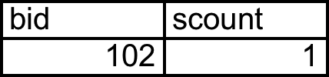
Views Instead of Relations in Queries
CREATE VIEW Redcount
AS SELECT B.bid, COUNT(*) AS scount
FROM Boats2 B, Reserves2 R
WHERE R.bid=B.bid AND B.color='red'
GROUP BY B.bid;
SELECT * from redcount;
SELECT bname, scount
FROM Redcount R, Boats2 B
WHERE R.bid=B.bid
AND scount < 10;

Slide 50
Subqueries in FROM
Like a “view on the fly”!
SELECT bname, scount
FROM Boats2 B, (SELECT B.bid, COUNT (*)
FROM Boats2 B, Reserves2 R
WHERE R.bid = B.bid AND B.color = 'red'
GROUP BY B.bid) AS Reds(bid, scount)
WHERE Reds.bid=B.bid
AND scount < 10

Slide 51
WITH a.k.a. common table expression (CTE)
Another “view on the fly” syntax:
WITH Reds(bid, scount) AS (SELECT B.bid, COUNT (*)
FROM Boats2 B, Reserves2 R
WHERE R.bid = B.bid AND B.color = 'red'
GROUP BY B.bid)
SELECT bname, scount
FROM Boats2 B, Reds
WHERE Reds.bid=B.bid
AND scount < 10

Slide 52
Can have many queries in WITH
Another “view on the fly” syntax:
WITH Reds(bid, scount) AS (SELECT B.bid, COUNT (*)
FROM Boats2 B, Reserves2 R
WHERE R.bid = B.bid AND B.color = 'red'
GROUP BY B.bid),
UnpopularReds AS (SELECT bname, scount
FROM Boats2 B, Reds
WHERE Reds.bid=B.bid
AND scount < 10)
SELECT * FROM UnpopularReds;

Slide 53
ARGMAX GROUP BY?
The sailor with the highest rating per age
WITH maxratings(age, maxrating) AS (SELECT age, max(rating)
FROM Sailors
GROUP BY age)
SELECT S.*
FROM Sailors S, maxratings m
WHERE S.age = m.age
AND S.rating = m.maxrating;

Slide 54
Content Break 8

Slide 55
Brief Detour: Null Values
Field values are sometimes unknown
SQL provides a special value NULL for such situations.
Every data type can be NULL
The presence of null complicates many issues. E.g.:
Selection predicates (WHERE)
Aggregation
But NULLs comes naturally from Outer joins

Slide 56
NULL in the WHERE clause
Consider a tuple where rating IS NULL.
INSERT INTO sailors VALUES (11, 'Jack Sparrow', NULL, 35);
SELECT * FROM sailors
WHERE rating > 8;
Is Jack Sparrow in the output?

Slide 57
NULL in comparators
Rule: (x op NULL) evaluates to … NULL!
SELECT 100 = NULL;
SELECT 100 < NULL;
SELECT 100 >= NULL;

Slide 58
Explicit NULL Checks
SELECT * FROM sailors WHERE rating IS NULL;
SELECT * FROM sailors WHERE rating IS NOT NULL;

Slide 59
NULL at top of WHERE
Rule: Do not output a tuple WHERE NULL
SELECT * FROM sailors;
SELECT * FROM sailors WHERE rating > 8;
SELECT * FROM sailors WHERE rating <= 8;

Slide 60
NULL in Boolean Logic
Three-valued logic:
SELECT * FROM sailors WHERE rating > 8 AND TRUE;
SELECT * FROM sailors WHERE rating > 8 OR TRUE;
SELECT * FROM sailors WHERE NOT (rating > 8);
General rule: NULL **column values** are ignored by aggregate functions
AND | T | F | N
T | T | F
F | F | F
N
OR | T | F | N
T | T | T
F | T | F
N
NOT | T | F | N
 | F | T

Slide 61
NULL in Boolean Logic
Three-valued logic:
SELECT * FROM sailors WHERE rating > 8 AND TRUE;
SELECT * FROM sailors WHERE rating > 8 OR TRUE;
SELECT * FROM sailors WHERE NOT (rating > 8);
General rule: NULL **column values** are ignored by aggregate functions
AND | T | F | N
T | T | F | N
F | F | F | F
N | N | F | N
OR | T | F | N
T | T | T | T
F | T | F | N
N | T | N | N
NOT | T | F | N
 | F | T | N

Slide 62
NULL and Aggregation
SELECT count(*) FROM sailors;
SELECT count(rating) FROM sailors;
SELECT sum(rating) FROM sailors;
SELECT avg(rating) FROM sailors;
General rule: NULL **column values** are ignored by aggregate functions

Slide 63
NULLs: Summary
NULL op NULL is NULL
WHERE NULL: do not send to output
Boolean connectives: 3-valued logic
Aggregates ignore NULL-valued inputs

Slide 64
Content Break 9

Slide 65
Testing SQL Queries
SQL Fiddle pages we provide in this class will typically help you answer the questions in the worksheets and vitamins.
But in real life:
not every database instance will reveal every bug in your query.
Eg: database instance without any rows in it!
Need to debug your queries
reasoning about them carefully
constructing test data.

Slide 66
Tips for Generating Test Data
Generate random data
e.g. using a service like mockaroo.com
Try to construct data that could check for the following potential errors:
Incorrect output schema
Output may be missing rows from the correct answer (false negatives)
Output may contain incorrect rows (false positives)
Output may have the wrong number of duplicates.
Output may not be ordered properly.

Slide 67
Content Break 10

Slide 68
Summary
You’ve now seen SQL—you are armed.
A declarative language
Somebody has to translate to algorithms though…
The RDBMS implementor ... i.e. you!

Slide 69
Summary Cont
The data structures and algorithms that make SQL possible also power:
NoSQL, data mining, scalable ML, network routing…
A toolbox for scalable computing!
That fun begins next week
We skirted questions of good database (schema) design
a topic we’ll consider in greater depth later

